Slide 1
Computability and Complexity over Finite Structures
(with the late Ashok Chandra)
STOC ‘79, FOCS ‘80, JCSS ‘80, ‘82
David Harel
The Weizmann Institute of Science

Slide 2
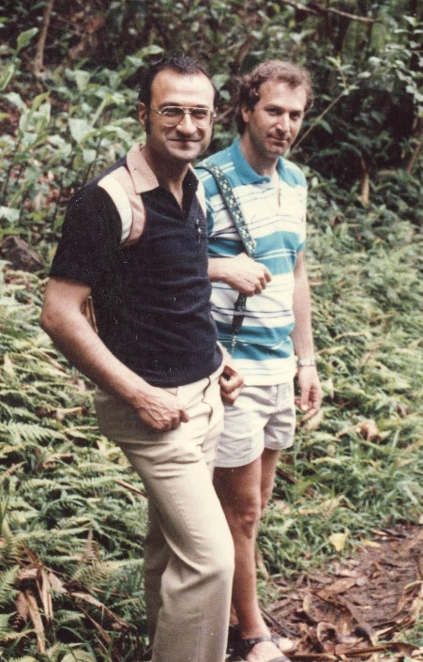
In dear Memory of Ashok Chandra
(1948-2014)

Slide 3
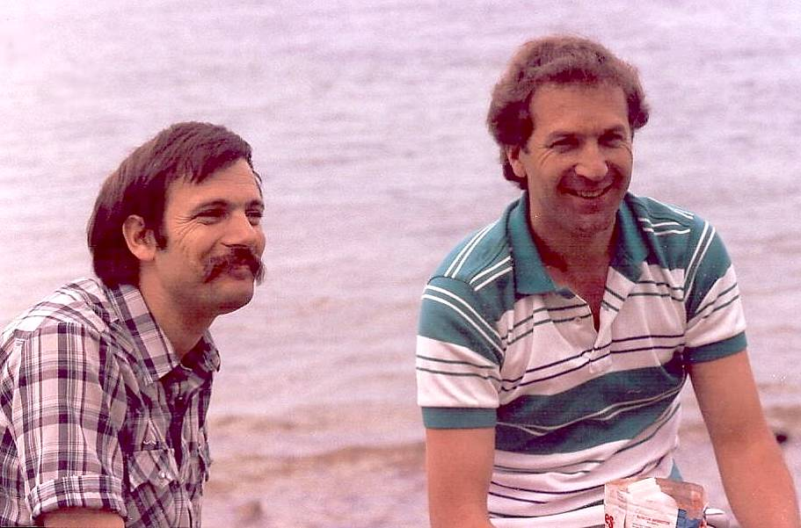
And, of course, dedicated to
the one and only Moshe Vardi
Brilliant scientist, dear friend, great colleague!

Slide 4
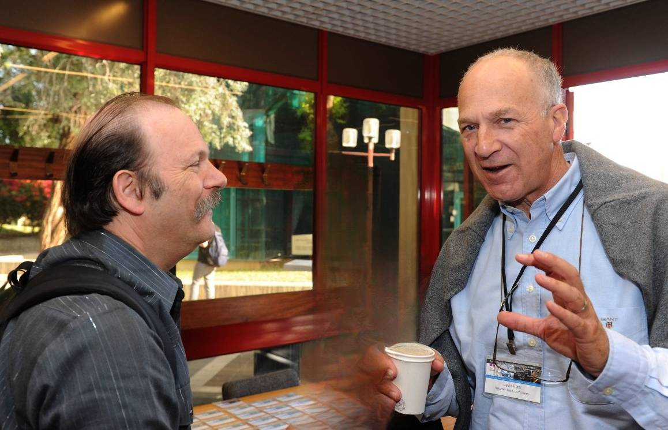
Also in memory of our hair…

Slide 5
Extending classical computability and complexity from numbers/words to general structures
(graphs, networks, databases,… essentially anything with structure)

Slide 6
Here now are some of the original slides from STOC 1979, intermixed with recent ones

Slide 7
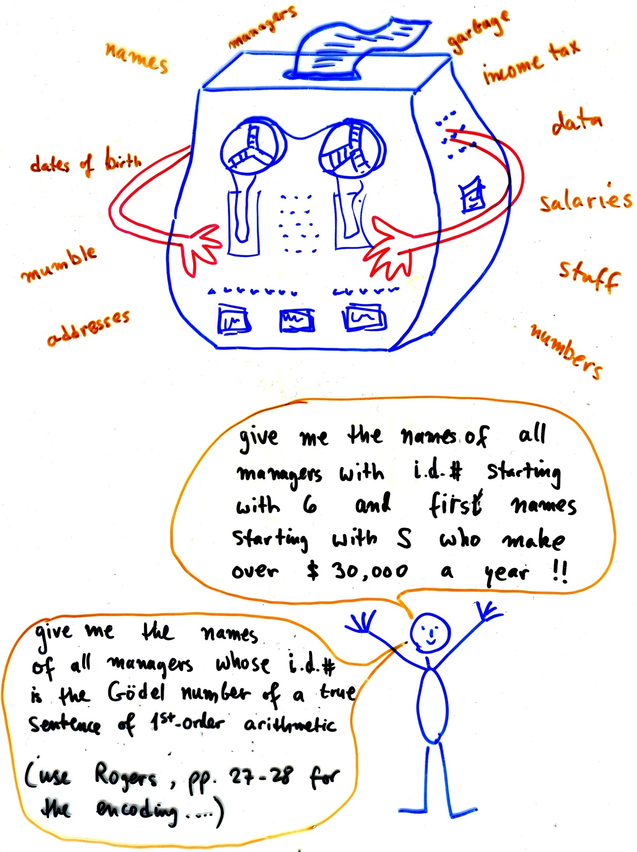

Slide 8
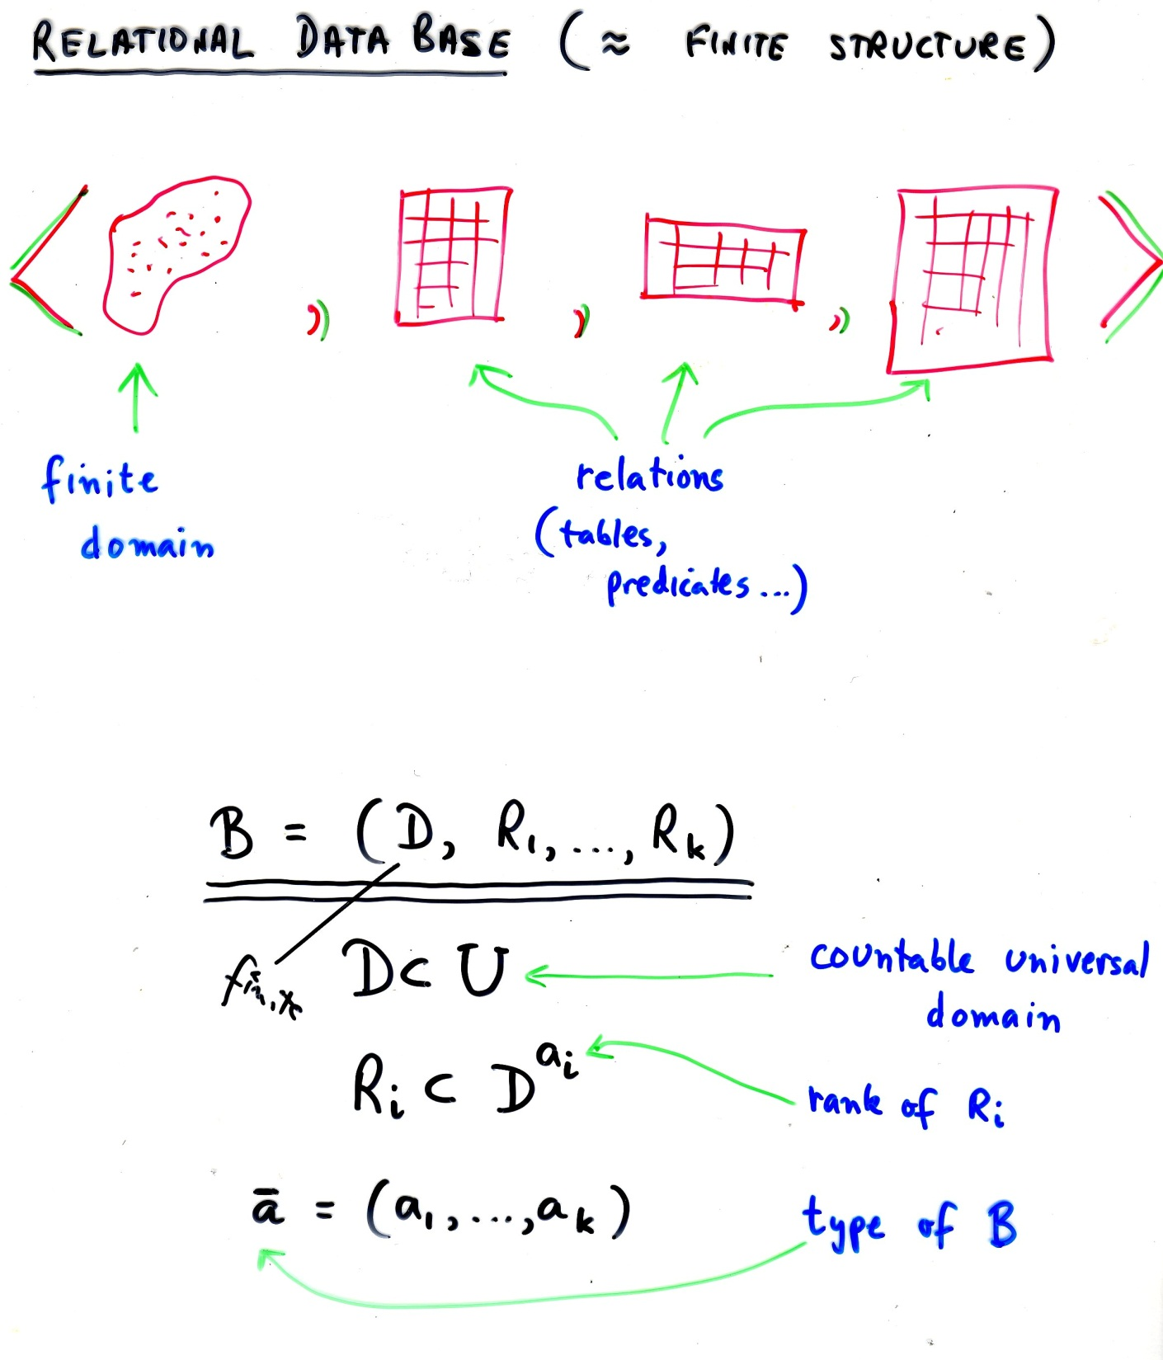

Slide 9
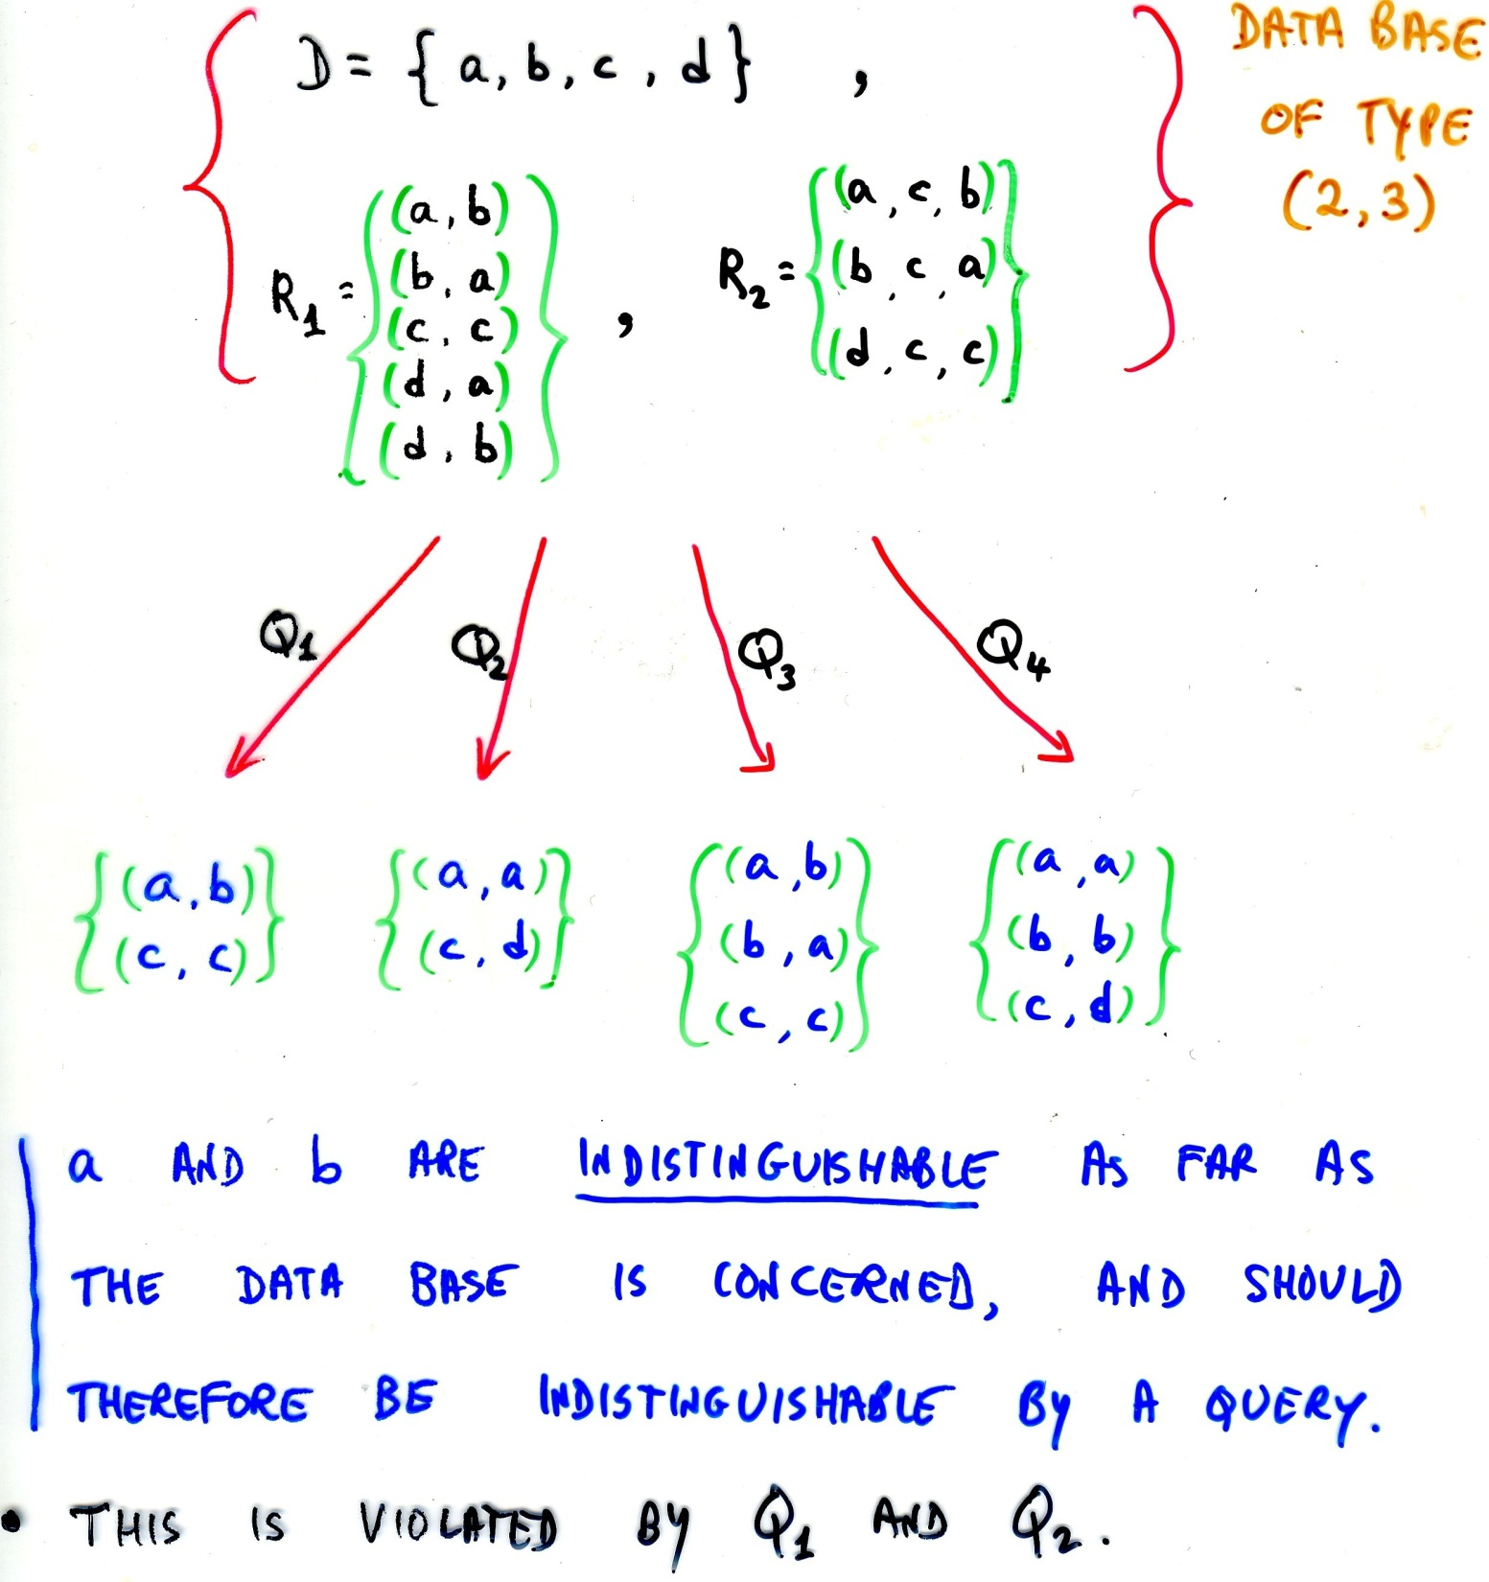

Slide 10
OK
not OK!
contains information not in the original structure

Slide 11
Now let’s change the original structure a little

Slide 12
this is now OK!

Slide 13
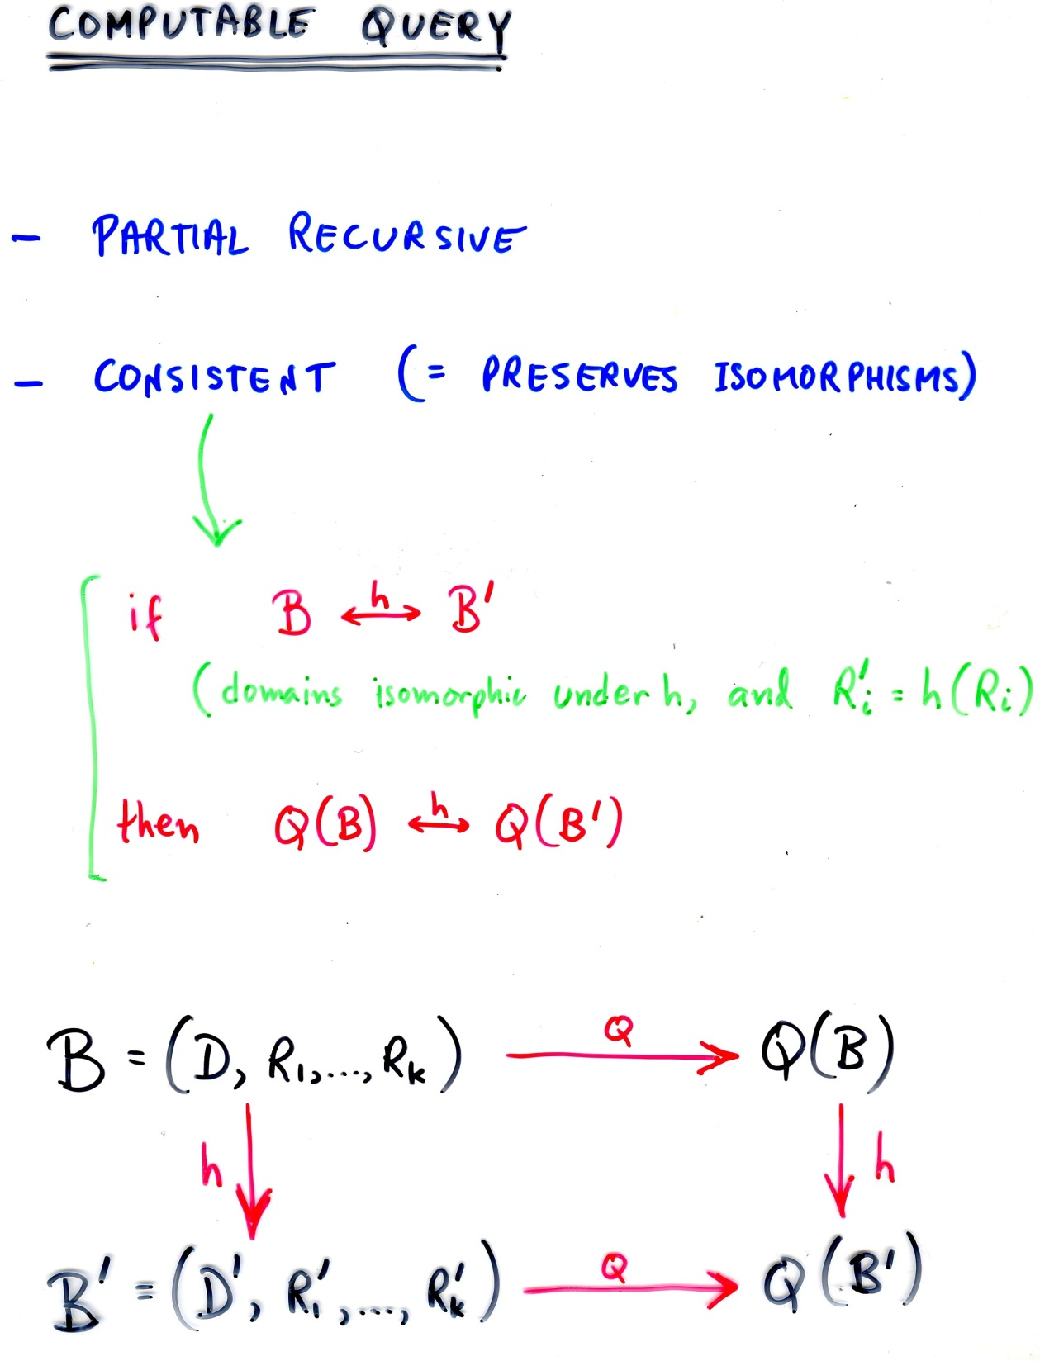
Computable a la Turing
This is the crucial thing

Slide 14
If we can find a complete language for the computable queries, we are done
(e.g., an analog of Turing machines)

Slide 15
Why not simply take the set of automorphism-preserving (“consistent”, or “generic”) Turing machines as a complete language?
Because even it’s syntax is not effective! By Rice’s theorem, genericity is undecidable

Slide 16
Back to STOC 1979

Slide 17
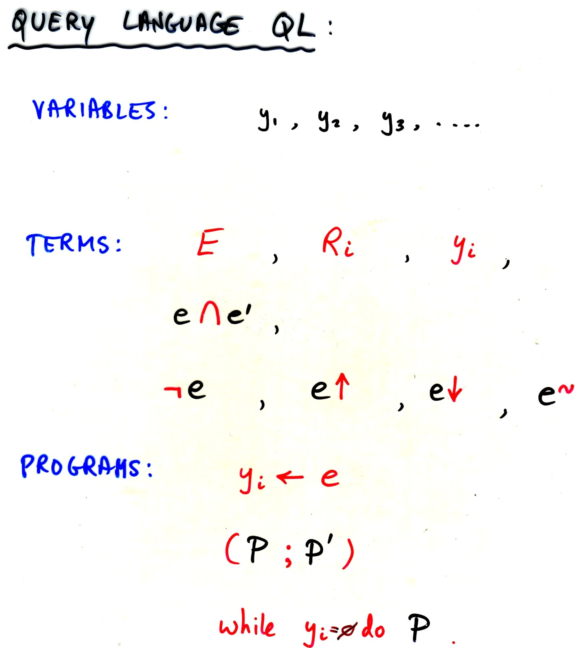

Slide 18
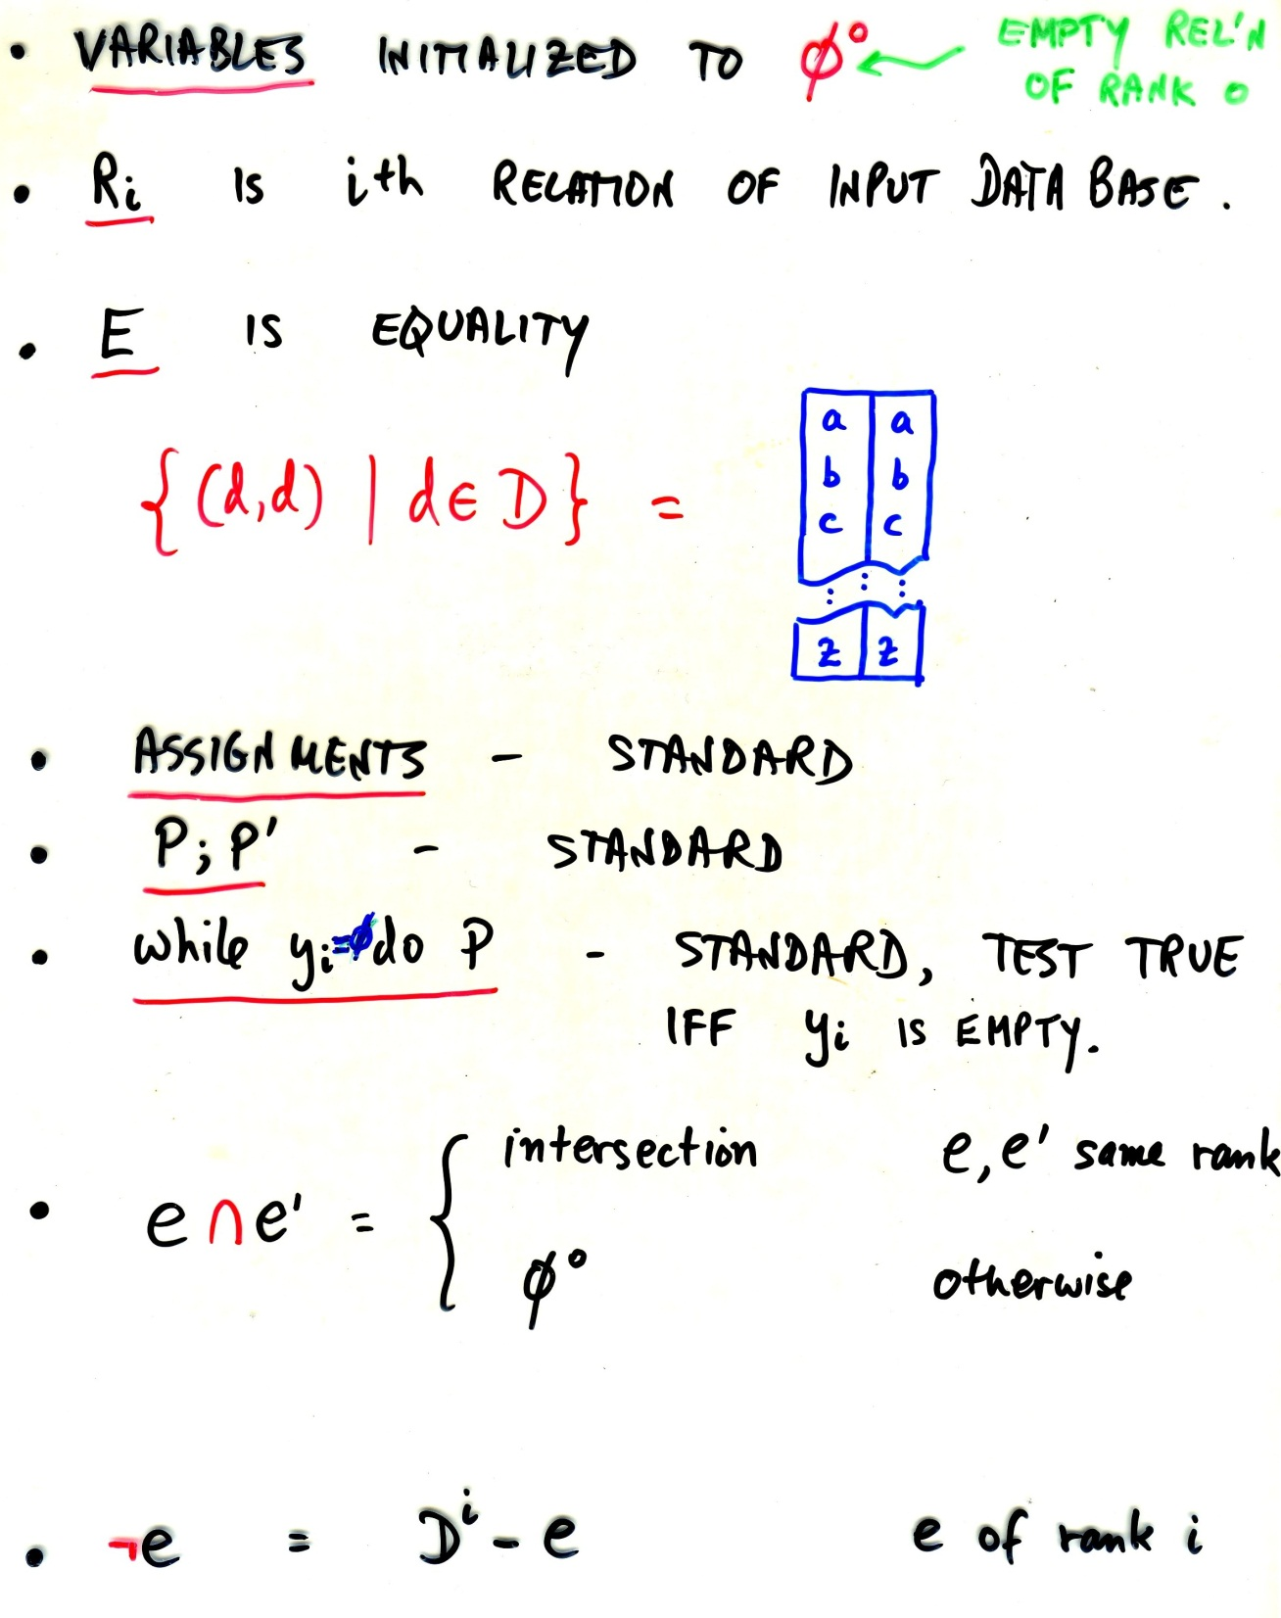

Slide 19
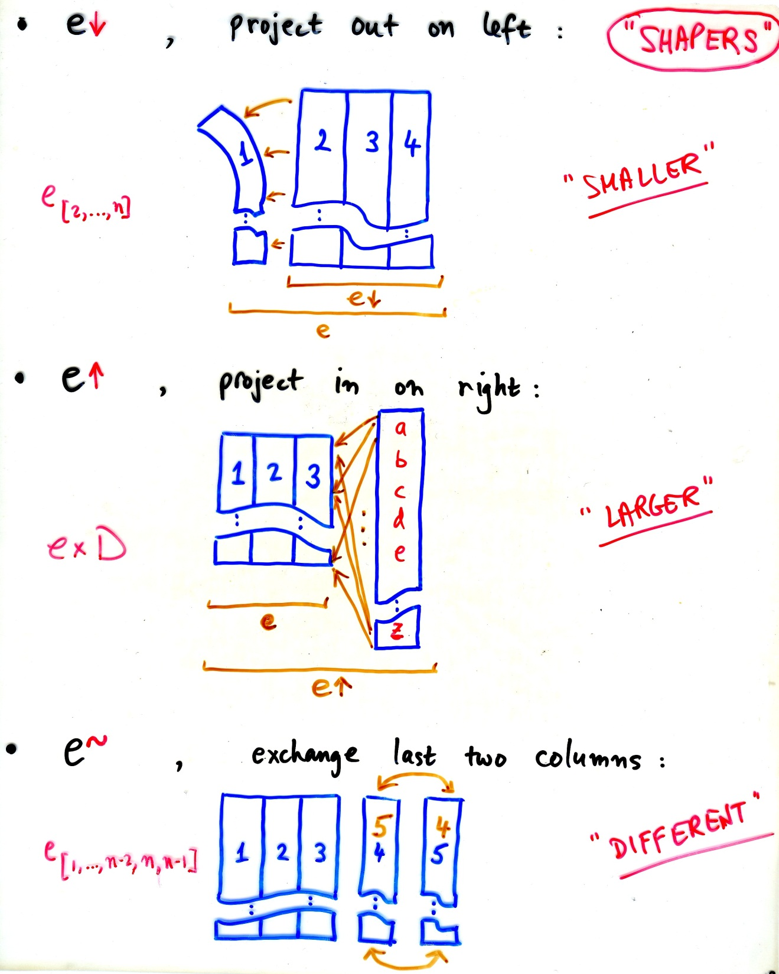

Slide 20
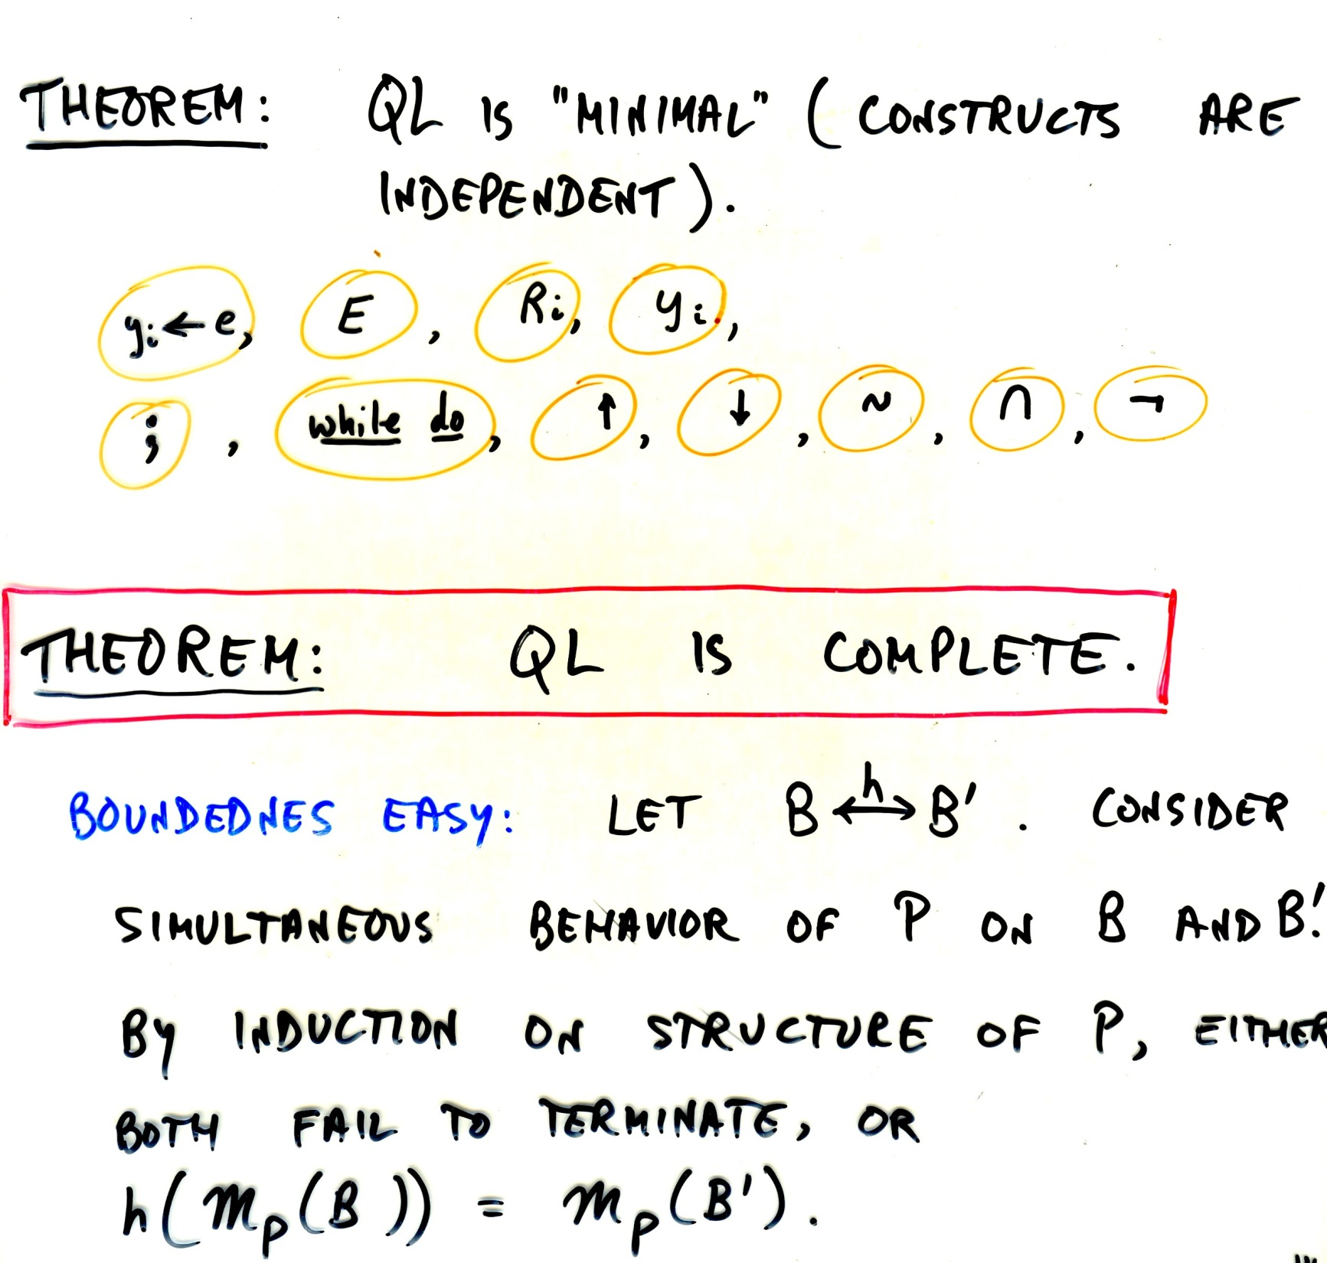

Slide 21
Completeness is not easy…

Slide 22
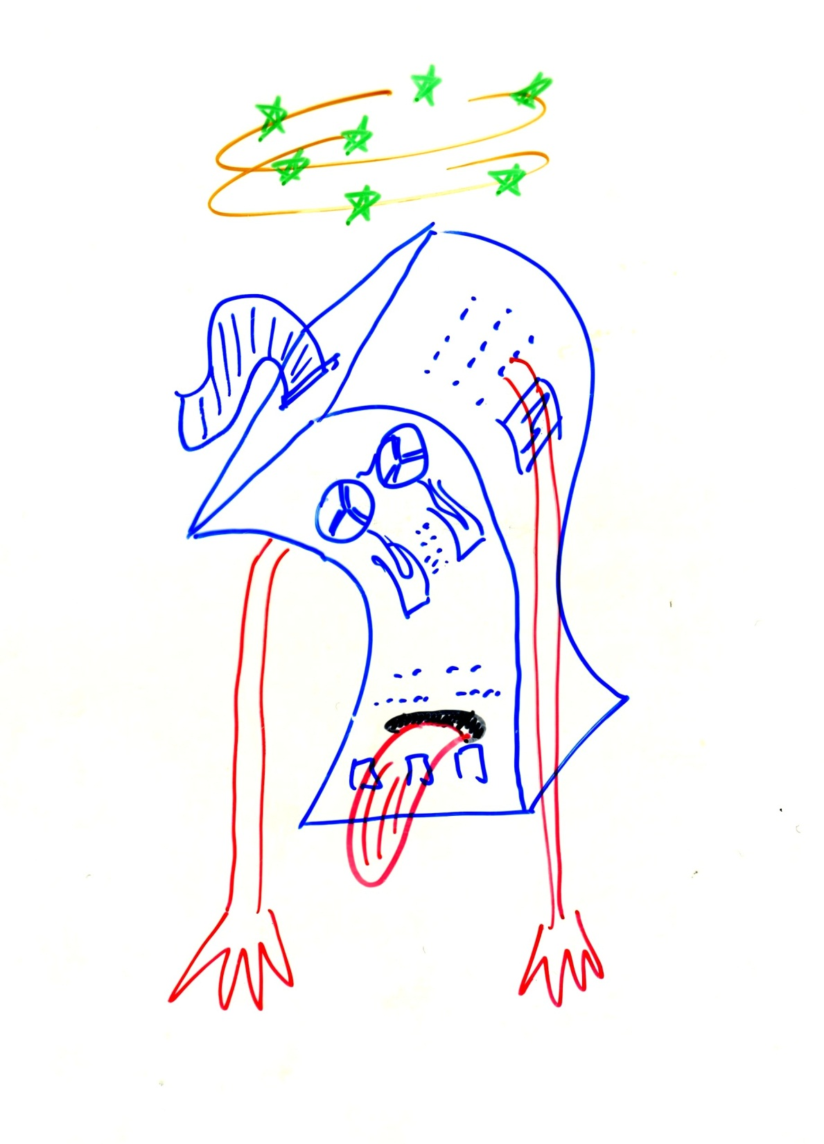

Slide 23
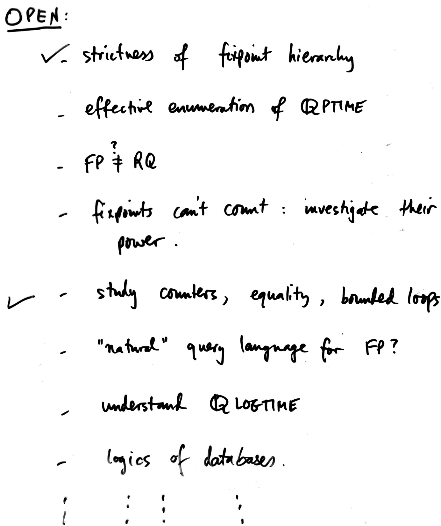
FOCS 1980, complexity theory on structures
closing slide

Slide 24
Is there an effective logic/language for the polynomial-time functions on general (not necessarily ordered) structures?
For ordered structures yes: FO(LFP), (Vardi, 1982; Immerman, 1982)

Slide 25
Is there an effective logic/language for the polynomial-time functions on general (not necessarily ordered) structures?
Still open, after 42 years…
Considered the central open problem in finite model theory and descriptive complexity

Slide 26
Computability over infinite recursive structures
(with T. Hirst, J. Comp. Sys. Sci. 1996)

Slide 27
Obtained several results, including completeness in the style of [CH ’79] for the (appropriately restricted) class of infinite recursive structures

Slide 28
Thank you for listening

